Slide 1
DBMS Mini-Project

Slide 2
agenda
About US
Problem Statement
Technology & Skill
Data Description
Data Dictionary
Problem Solving
ER DIAGRAM
CODE SNIPPETS
Questions & Answers
FUTURE STEPS
Conclusion

Slide 3

About Us Team-Member’s Name
Shruti Bansal
Anjali Dubey
MD Modassir
Nimisha Khandelwal
Karpagaganesh N
Akshita Gupta

Slide 4
PROBLEM STATEMENT
The task at hand involves utilizing SQL queries to extract valuable information from the dataset provided. By leveraging SQL, one can retrieve specific columns or filter data based on certain conditions. After the necessary information has been extracted, it should be analyzed to uncover significant insights and meaningful conclusions. In order to effectively communicate the findings, they should be presented in a clear and concise manner. The data should be examined closely to understand the entity-relationship and entity attributes. Overall, the use of SQL queries and analysis of the data can provide valuable insights that can help in decision making and problem solving. With the right approach and a comprehensive understanding of the data, valuable insights can be uncovered to help meet the goals of the task.

Slide 5
Technology & Skill
Skill – Standard Query Language (SQL)
Technology/IDE – MySQL

Slide 6

Data Description
Given dataset comprises of 12 tables in total.
It has a conceptual ERD.
It contains data of all the IPL matches, bids, players and all the other relevant and necessary information of 2017 and 2018 session.
The Indian Premier League (IPL) is a professional Twenty20 cricket league in India, featuring teams representing different cities and states across the country.

Slide 7
Data Dictionary
Ipl Stadium : It contains data of all the stadiums, it has total 6 columns
Ipl team : contains team name and city of origin, it has 4 columns
Ipl player : it contains player name with their performance details. No of columns is 4
Ipl team player : it has information of player and their role in their respective teams.
Ipl tournament : It has information of all the tournaments, no of teams participated ,total matches and duration of tournament.
Ipl match : It has 7 columns and contains match related data, team participating ,match winner.
Ipl match schedule : It contains total match fixture, their venues, date, time Of a tournament. Total 9 columns
Ipl Bidder details : Details of all the users who registered themselves as bidder on the platform. Total 5 columns
Ipl bidding details: It contains bidding details such as no of bids, total points, tournament id.
Ipl Team standings : It contains performance of every team in each tournament,

Slide 8
Problem Solving
Database Creation
Understanding/Fetching Data
Insight Generation
Created database by running the database script in hand.
Examined the given dataset for better understanding of entity-relationship and entities attribute.
Fetched data using MySQL queries to retrieve required information.
Fetched insightful data using MySQL by creating virtual columns and using different functions.

Slide 9
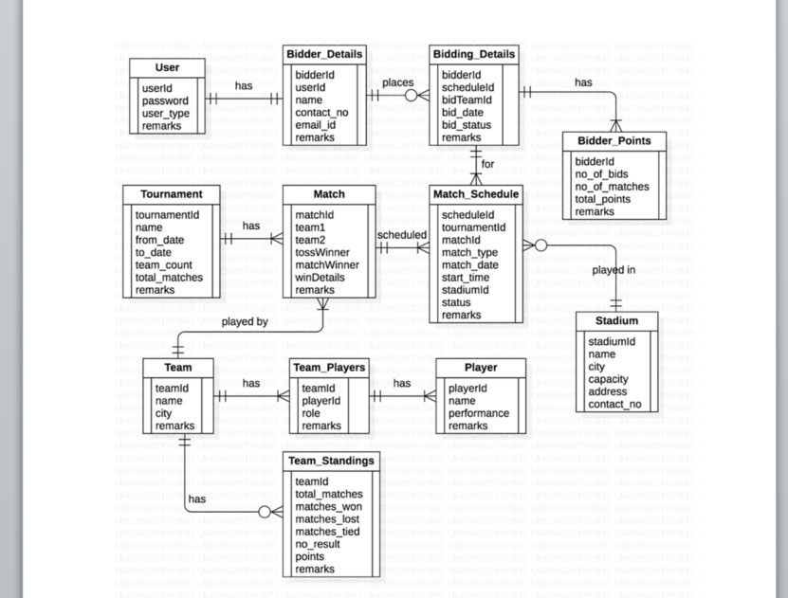
ER Diagram

Slide 10
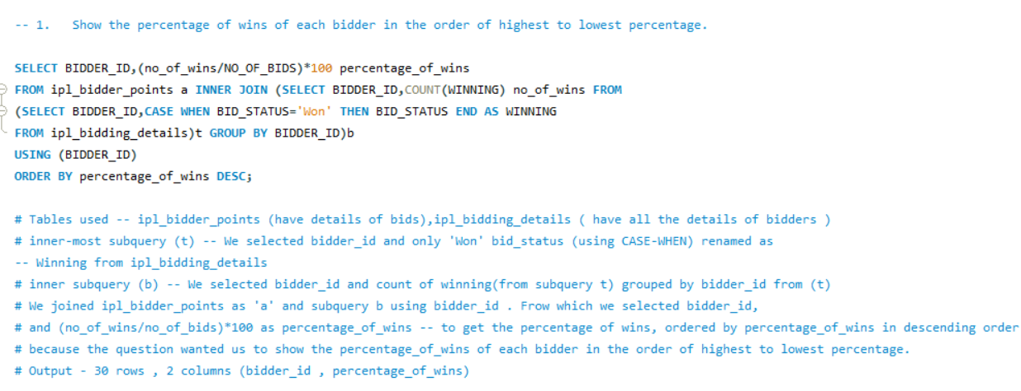
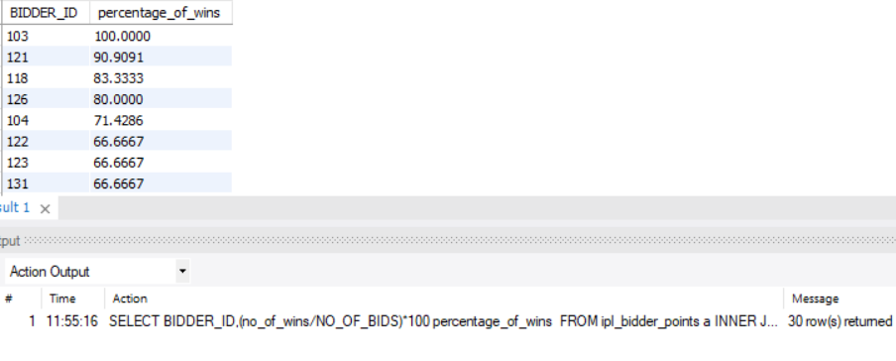
Question & Answers

Slide 11
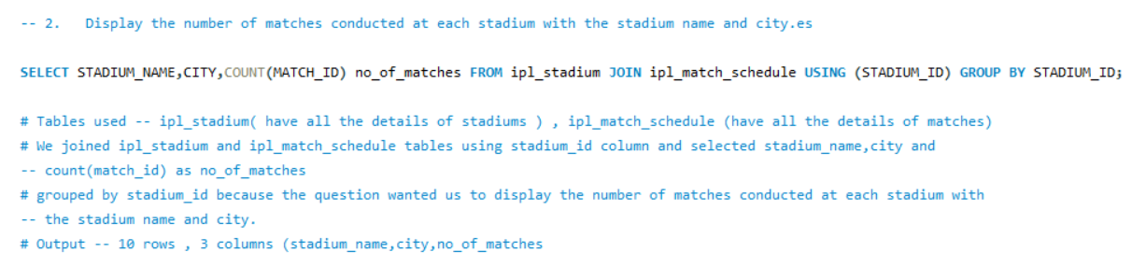
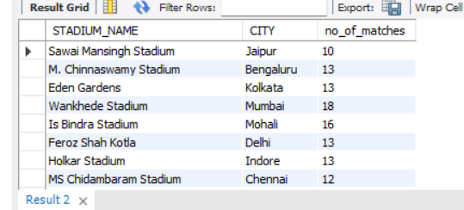

Slide 12
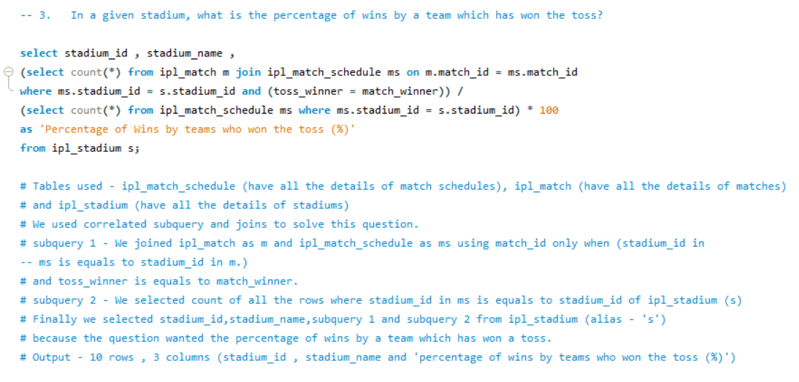
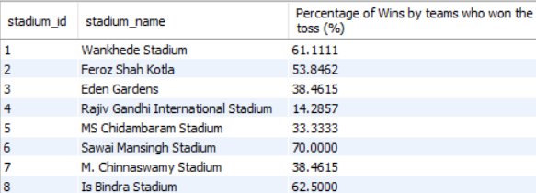

Slide 13
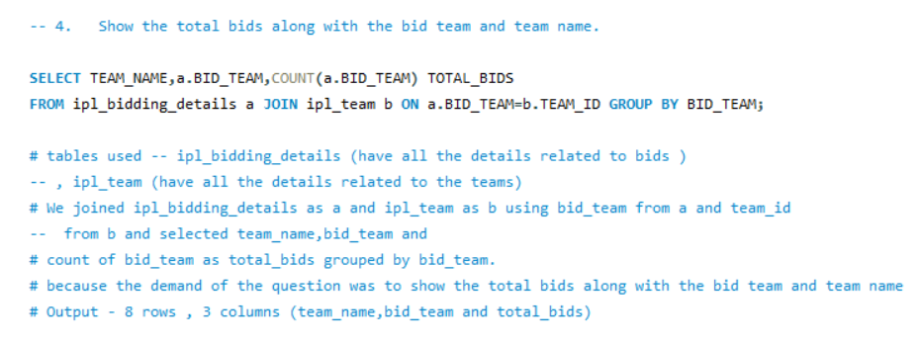
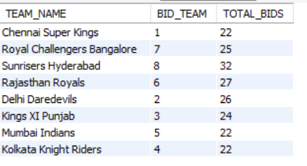
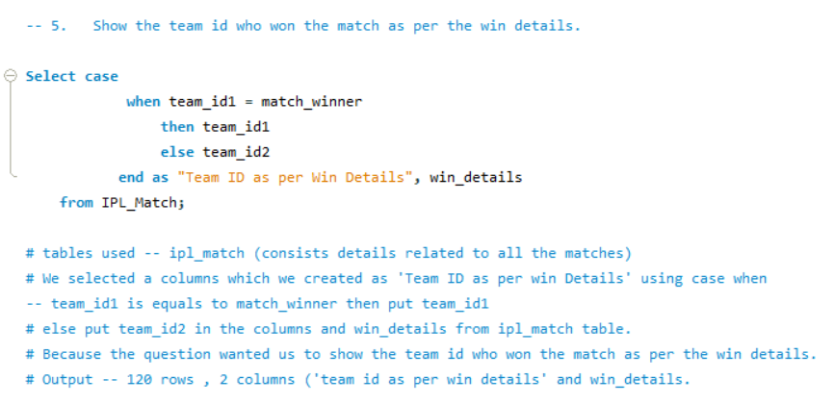
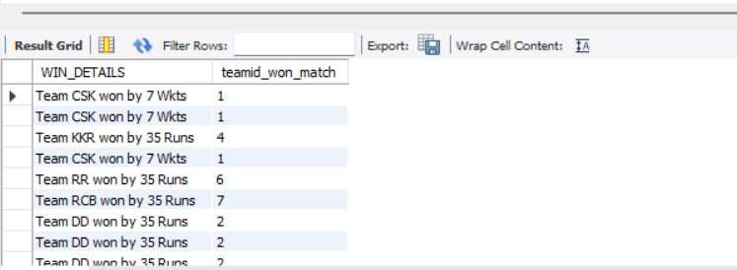

Slide 14
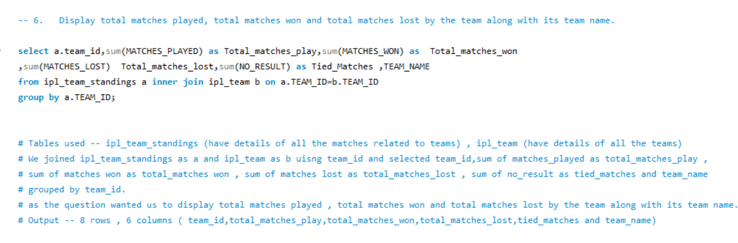
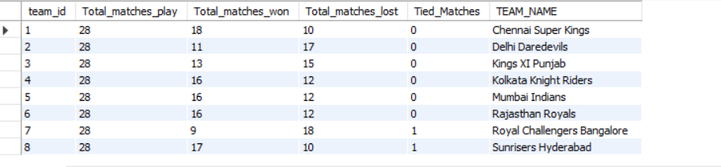
v

Slide 15
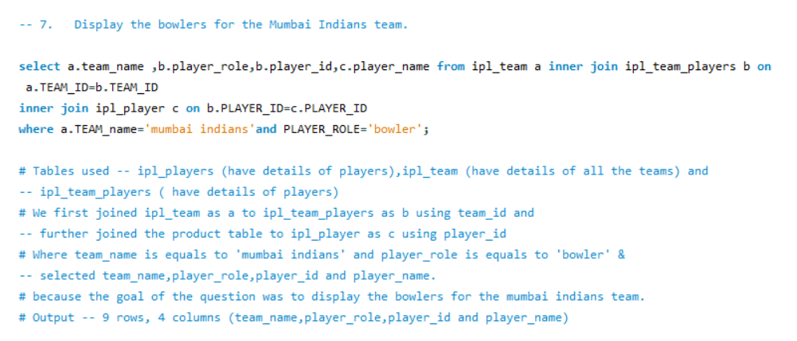
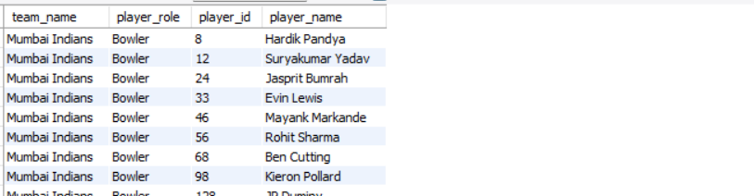

Slide 16
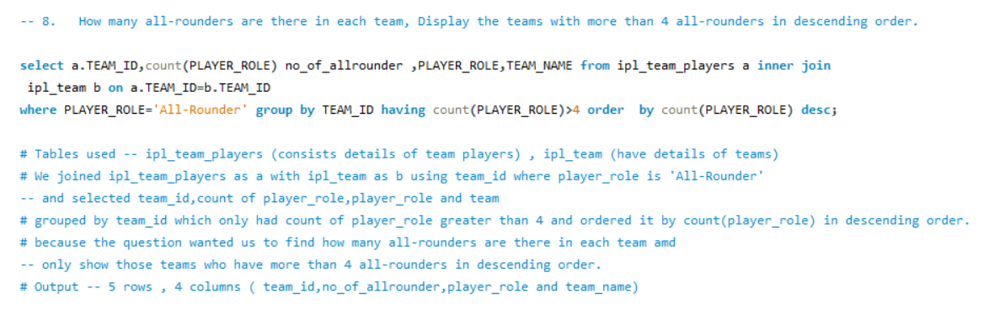
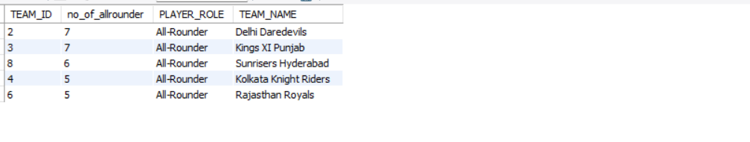

Slide 17
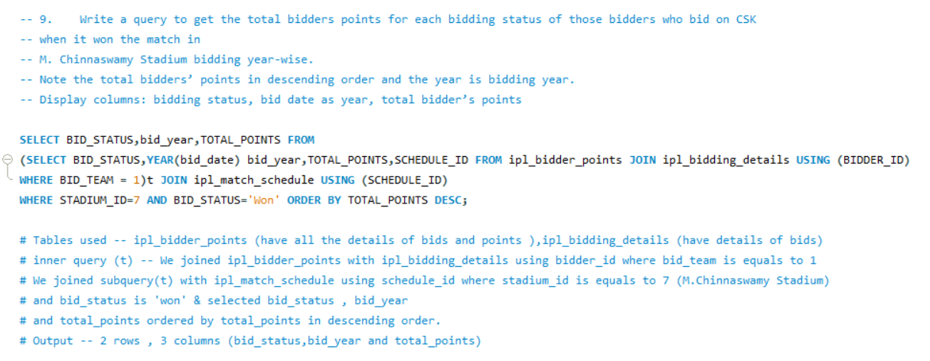
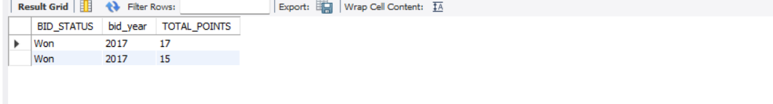

Slide 18
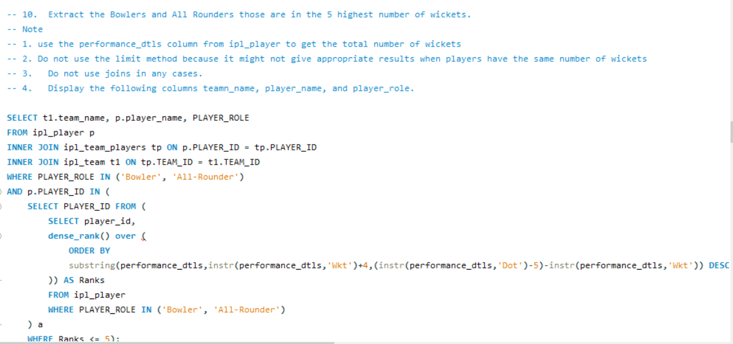
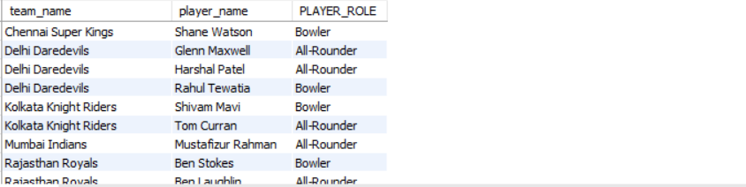

Slide 19
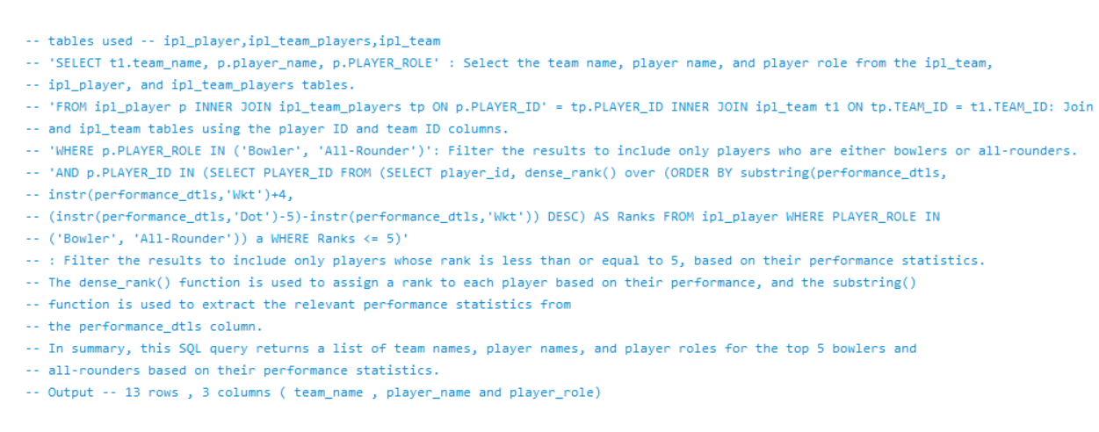

Slide 20
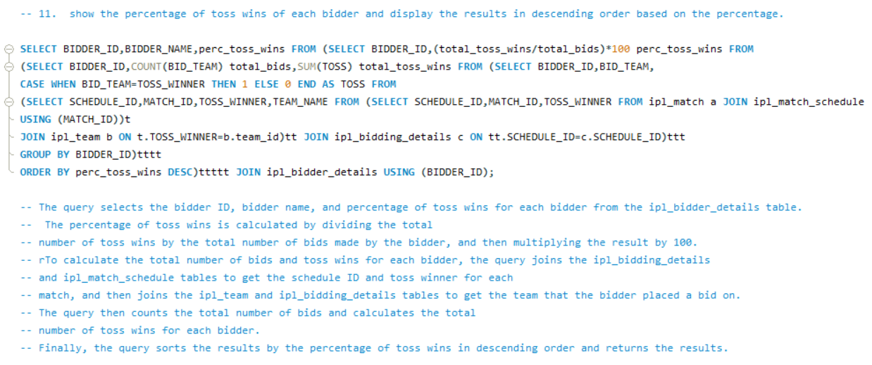
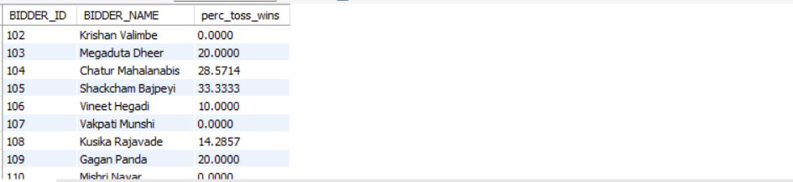

Slide 21
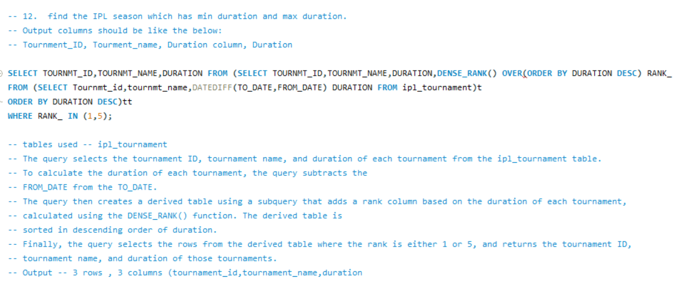


Slide 22
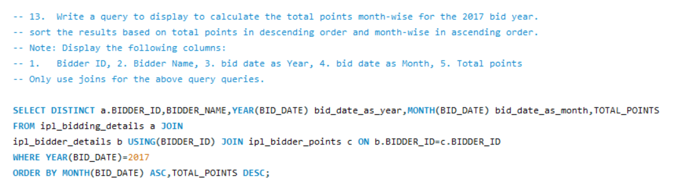
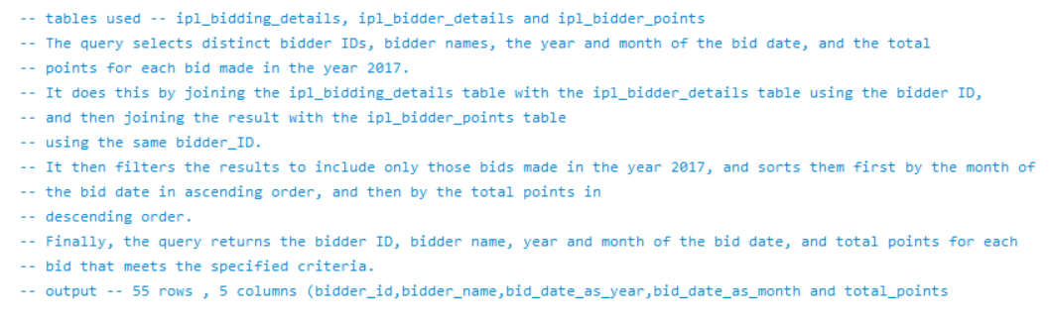

Slide 23
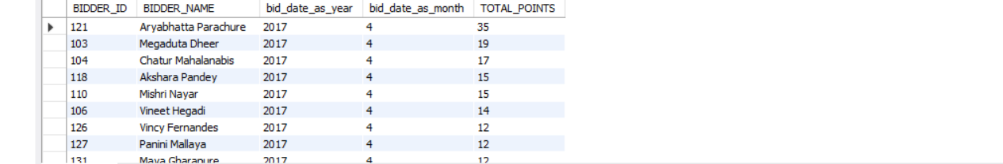

Slide 24
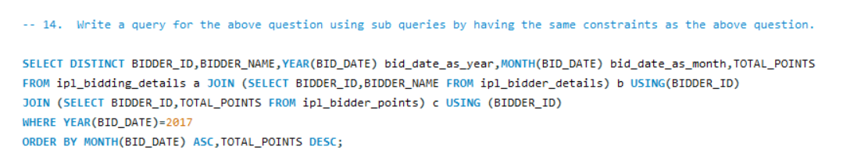
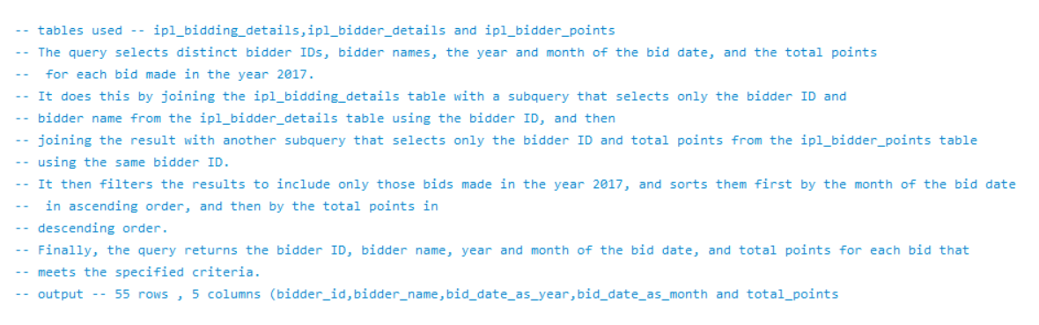

Slide 26
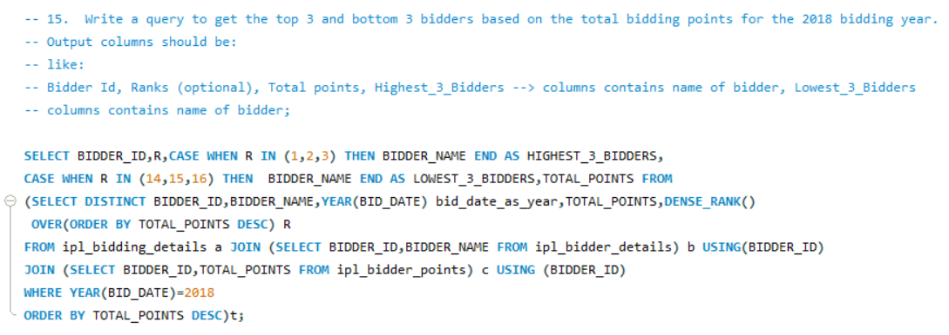
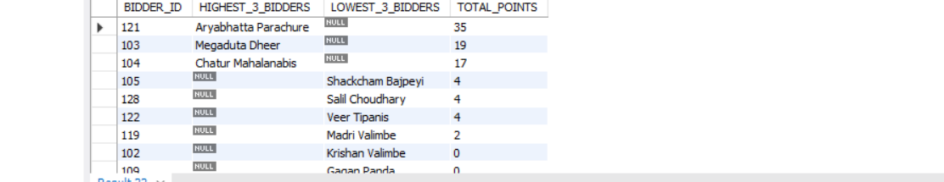

Slide 27
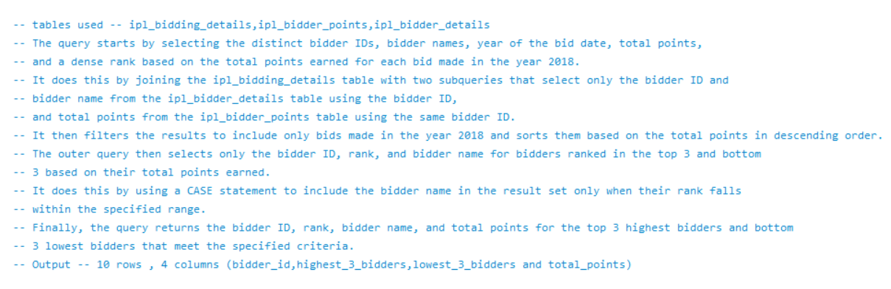

Slide 28
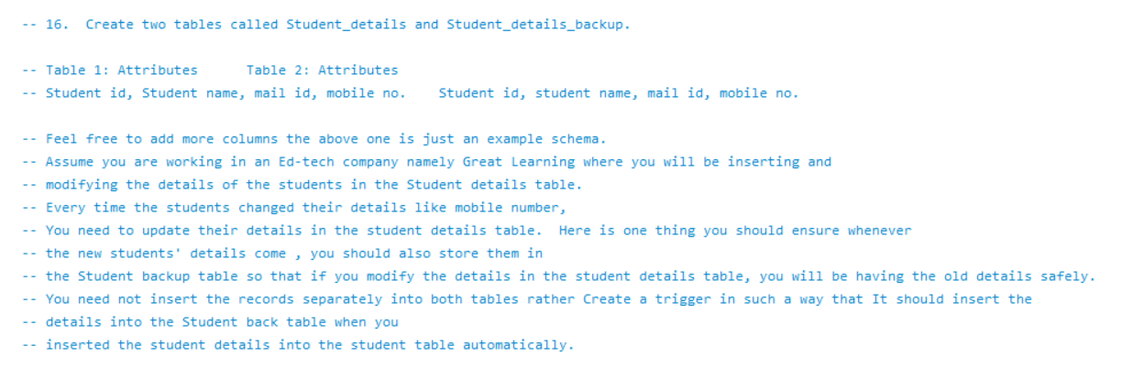

Slide 29
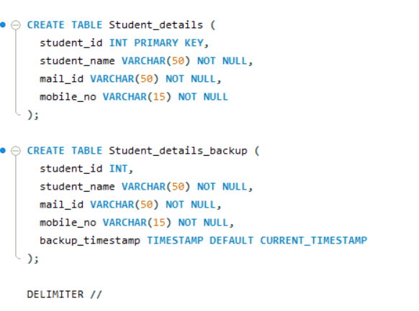
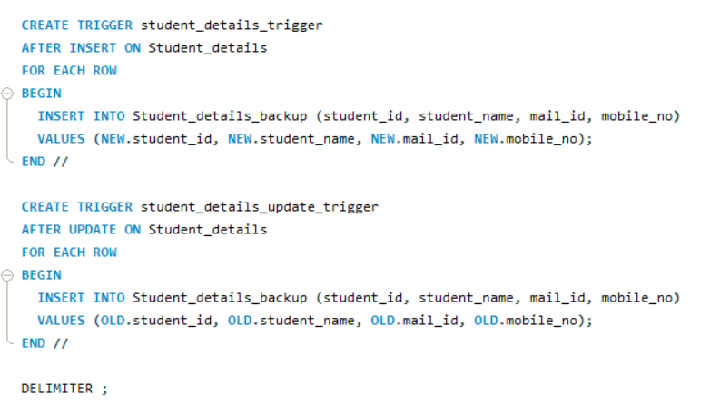

Slide 30
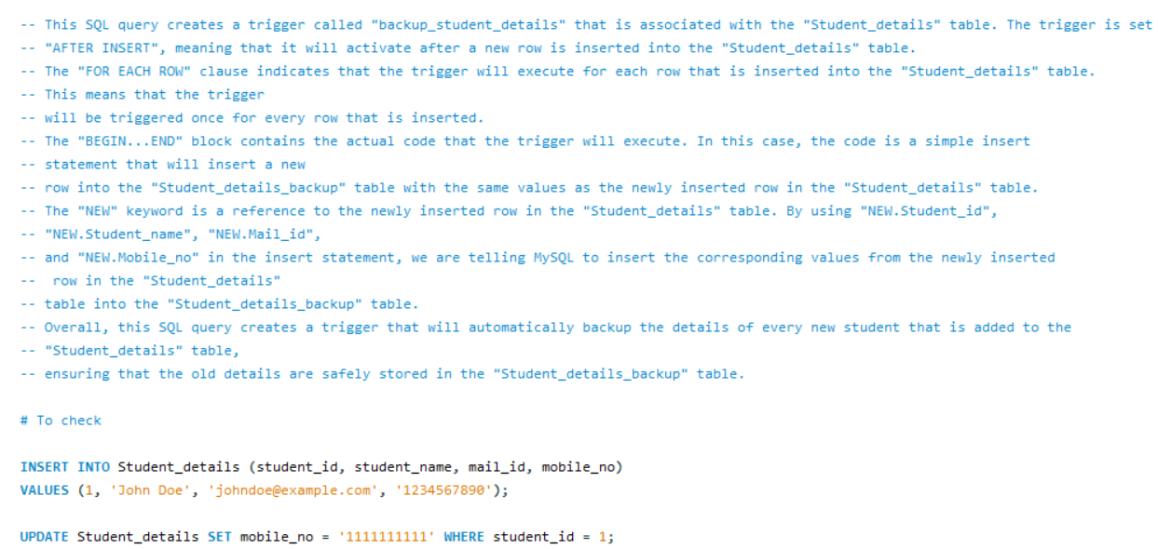
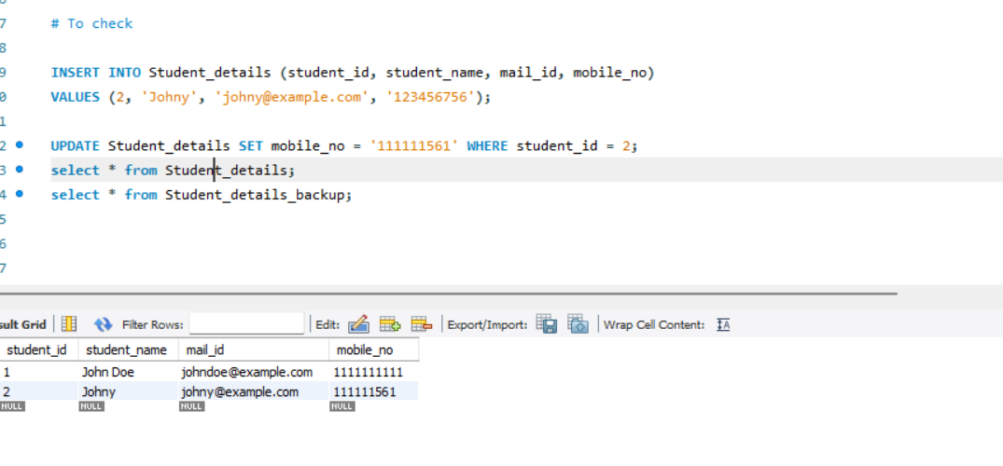

Slide 31
Future Steps
Enhance the application by adding a feature that displays a comprehensive summary of each match, including ball-by-ball commentary, player statistics, and performance graphs for each team.
Enable users to share their predictions, leaderboard position, and victories on social media platforms, allowing them to share their achievements with friends and followers.
Optimize the app's performance by reorganizing and storing data more efficiently, enabling it to handle high volumes of users without experiencing slowdowns or crashes.
Obtain insights into user needs and expectations through surveys and feedback sessions, and use this feedback to continuously improve and enhance the application..

Slide 32
Conclusion
​By utilizing SQL queries to extract valuable data and analyzing it thoroughly, we were able to gain useful insights that can help the company achieve success. Our analysis has led us to suggest several future steps that the company can take to improve its operations and make better business decisions. By implementing these steps, the company can stay ahead of its competition and continue to grow and succeed in the long term. It is essential to continue monitoring and analyzing data regularly to stay on top of the latest trends and make informed decisions that benefit the company and its stakeholders.

Slide 33
Thank You

